Slide 1




Analytical Tight-Binding Expressions from First Principle Calculations
1
20
By Collins Kariuki^{1,2}
Advisors: Sophie Beck² and Olivier Gingras²
Department of Physics and Astronomy, Pomona College, Claremont, CA 91711 ¹
Center for Computational Quantum Physics, Flatiron Institute, New York, NY 10010 ²

Slide 2




01.
MOTIVATION & AIM
2
20
Whom do you serve?
A brief take on the tight-binding model.
Notes:
Insert white palm after “Whom do you serve?”

Slide 3
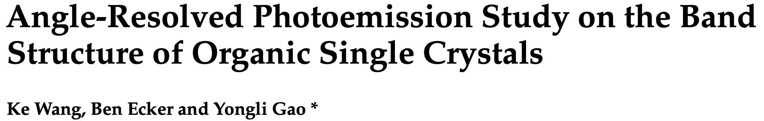
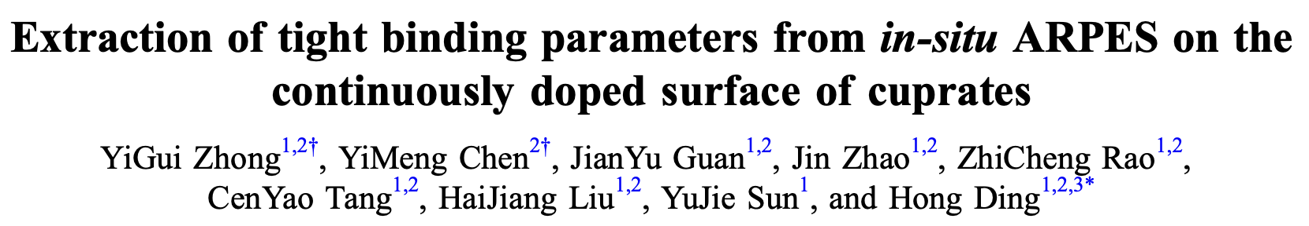
THE TIGHT-BINDING MODEL, VERY BRIEFLY.
A simple semi-empirical model used to study the behavior of conductors, semiconductors, and insulators by investigating LOCAL electron interactions.
3
Whom do you serve?
20
Experimental physicists can use the TB model to compare their measurements, such as those gotten from experiments like Angle-Resolved Photoemission Spectroscopy (ARPES), with theoretical predictions.
Notes:
ARPES is a powerful technique for directly probing the energy- and momentum-resolved electronic structure, which is fundamental in CMP.
DEFINITION OF SEMI-EMPIRICAL: Semi-empirical refers to a type of scientific model or method that combines both theoretical and empirical elements. In other words, it incorporates theoretical principles and assumptions along with experimental or observed data to make predictions or explain phenomena.

Slide 4


PROJECT AIM
The aims of my project were:
Create a function that would generate a succinct analytical Hamiltonian drawing from the TB model’s mathematical tractability.
1
4
20
2
Make an interactive tutorial on how the function works
Both would be added to TRIQS (Toolbox for Research on Interacting Quantum Systems).

Slide 5

BACKGROUND & INTRODUCTION
02.
5
20
Hierarchy of complexity.
TB as a minimal model.
Chief Hamiltonian Equation

Slide 6
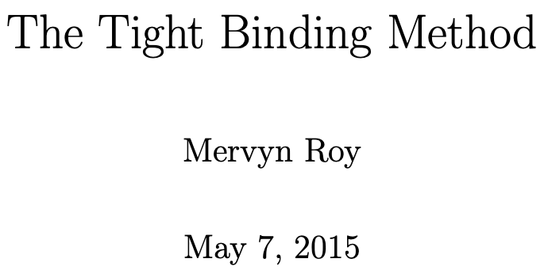
HIERARCHY OF COMPLEXITY.
For small systems with few electrons, configuration interaction can be employed to calculate the accurate many-electron wavefunction.
100-1000 atoms, DFT employed to find the ground state density and energy of the interacting system without explicitly calculating the many-electron wavefunction.
>10,000 atoms, we adopt a semi-empirical approach, including adjustable parameters to match experimental observations.
6
20
An analytical TB Hamiltonian with a RESTRICTED number of parameters can help experimentalists fit and confirm their data.

Slide 7

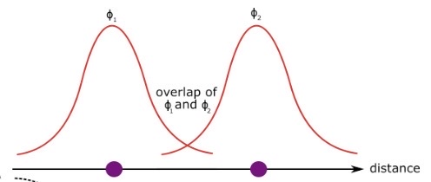
TIGHT-BINDING MODEL, DETAILS.
The tight-binding model:
Model electrons as tightly bound to atoms.
7
Assumes that main behavior arises from electrons as they hop between NEIGHBORING atomic orbitals
20
Because of wave function overlap on the pair of atoms.
Notes:
TODO:
THE BASIC IDEA BEHIND THE TIGHT-BINDING MODEL IS THAT THE ELECTRON’S WAVE FUNCTION HAS A SIGNIFICANT OVERLAP WITH THE ATOMIC ORBITALS OF THE NEIGHBORING ATOMS.

Slide 8
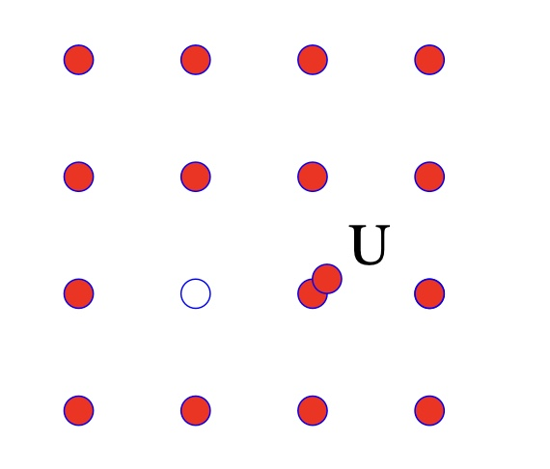
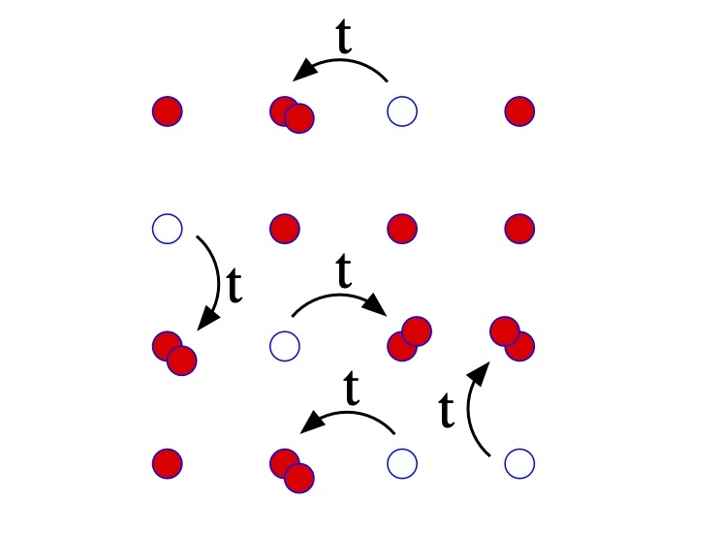



THE TB MODEL AS A PRIME MINIMAL MODEL.
TB captures essential physics of electron motion within a crystal lattice
Neglects many of the detailed electronic potential interactions.
Electron motion?
8
20
TB model is a simplified way of representing how electrons move in a solid material
Notes:
-------
TODO:
DRAG (FRICTION) ANALOGY? (Although we do not include an interaction term in this model, it is a great starting point in terms of perturbation theory for example, where we look for solutions close to the non-interacting case and add interactions as a perturbation).
IT SURE IS BETTER FOR WEAKLY INTERACTING SYSTEMS BUT IS ALSO BETTER SUITED FOR STRONGLY LOCALIZED SYSTEMS WHERE ELECTRONS ARE STRONGLY BOUNDED TO ATOMS.
!!!! ALTHOUGH WE DO NOT INCLUDE AN INTERACTION TERM IN THIS MODEL, IT IS A GREAT STARTING POINT IN TERMS OF PERTURBATION THEORY, FOR EXAMPLE, WHERE WE LOOK FOR SOLUTIONS CLOSE TO THE NON-INTERACTING CASE and ADD INTERACTIONS AS A PERTURBATION.
THERE ARE WAYS TO STUDY THE STRONG COUPLING CASE TOO, BUT STILL REQUIRES TO HAVE A NON-INTERACTING STARTING POINT AND TIGHT-BINDING MODEL ARE GREAT FOR THAT. !!!!

Slide 9
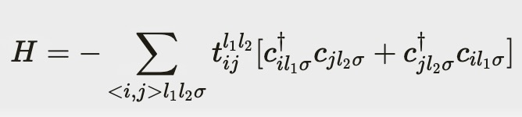
THE HAMILTONIAN EQUATION.
The TB Hamiltonian (kinetic energy term solely):
9
20
The hopping integral (the “strength” of the hopping)
Notes:
Thus cˆ{\dagger} (cˆ) creates (destroy) fermions of spin σ at site j.
TODO:
EXPLAIN THE 2 ADDITIONAL TERMS: THE POTENTIAL ENERGY (U) TERM {actually in the full H_TB} (The second term is an on-site term that describes the energy of placing an electron at a lattice site) & THE CHEMICAL POTENTIAL TERMS (MU).
CREATION & ANNIHILATION OPERATORS DESCRIBE THE ENERGY GAINED OR LOST WHEN ELECTRONS HOP FROM ONE ORBITAL TO THE NEXT.
===========
THE TB APPROACH IS FITTED ON RESULTS FROM A METHOD THAT INCLUDE INTERACTIONS.
IT SURE IS BETTER FOR WEAKLY INTERACTING SYSTEMS BUT IS ALSO BETTER SUITED FOR STRONGLY LOCALIZED SYSTEMS WHERE ELECTRONS ARE STRONGLY BOUNDED TO ATOMS.
!!!! ALTHOUGH WE DO NOT INCLUDE AN INTERACTION TERM IN THIS MODEL, IT IS A GREAT STARTING POINT IN TERMS OF PERTURBATION THEORY, FOR EXAMPLE, WHERE WE LOOK FOR SOLUTIONS CLOSE TO THE NON-INTERACTING CASE and ADD INTERACTIONS AS A PERTURBATION.
THERE ARE WAYS TO STUDY THE STRONG COUPLING CASE TOO, BUT STILL REQUIRES TO HAVE A NON-INTERACTING STARTING POINT AND TIGHT-BINDING MODEL ARE GREAT FOR THAT. !!!!
Even though the TB model itself doesn't consider electron-electron interactions, it's based on data obtained from more complex methods that do include interactions. The model is "fitted" to these results, meaning that its parameters are adjusted to match the behavior of electrons in the real material, interactions included.

Slide 10

03.
METHODS & DATA ANALYSES
10
20
First principles to simple TB model; interfaces and features

Slide 11


HIERARCHY OF S/WARE. WHERE DO I COME IN?
Ab initio (first principles) DFT calculation
Wannier interpolation.
A simple approximate tight-binding model !!!
11
20
Notes:
Wannier functions provide a localized representation of the electronic states within the crystal.
These are a set of orthonormal wave functions that one can always construct from Bloch functions, and which are plausibly localized on atomic sites.
NB: Each Wannier function describes the probability density of finding an electron near a particular lattice site.
The key feature of Wannier functions is that they form a complete set, meaning that any wave function in the crystal can be expressed as a linear combination of these localized functions.
===================
ABOUT WANNIER90
Changing the basis wave function set from Bloch wave functions to Maximally Localized Wave Functions.
Efficiency: The number of Wannier functions is typically much smaller than the number of Bloch functions, leading to substantial computational savings in subsequent calculations.
QUANTUM ESPRESSO IS A SUITE FOR FIRST-PRINCIPLES ELECTRONIC-STRUCTURE CALCULATIONS AND MATERIALS MODELING.

Slide 12
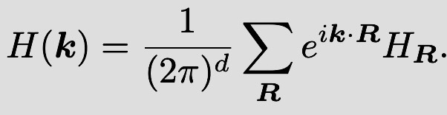
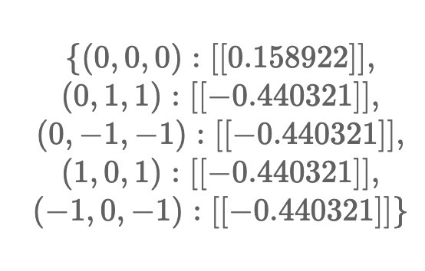
ACTUAL METHODS
1
The central equation that we are trying to model:
2
Interface with Wannier90 to get all the hopping integrals
12
Hopping integrals from home unit cells to these coordinates.
Symmetrical.
20
3
Apply cutoffs to the hopping integrals, selecting only the desired ones, using PythTB. Minimal!
Notes:
TODO:
Explain that you won’t have the time to go into the nitty-gritty of the function but that the equation below is what is basically encapsulated.
Include a picture of the hopping parameters.
SHOW SYMMETRICAL HOPS.
Interface with Wannier90 to get the hopping parameters/integrals.

Slide 13
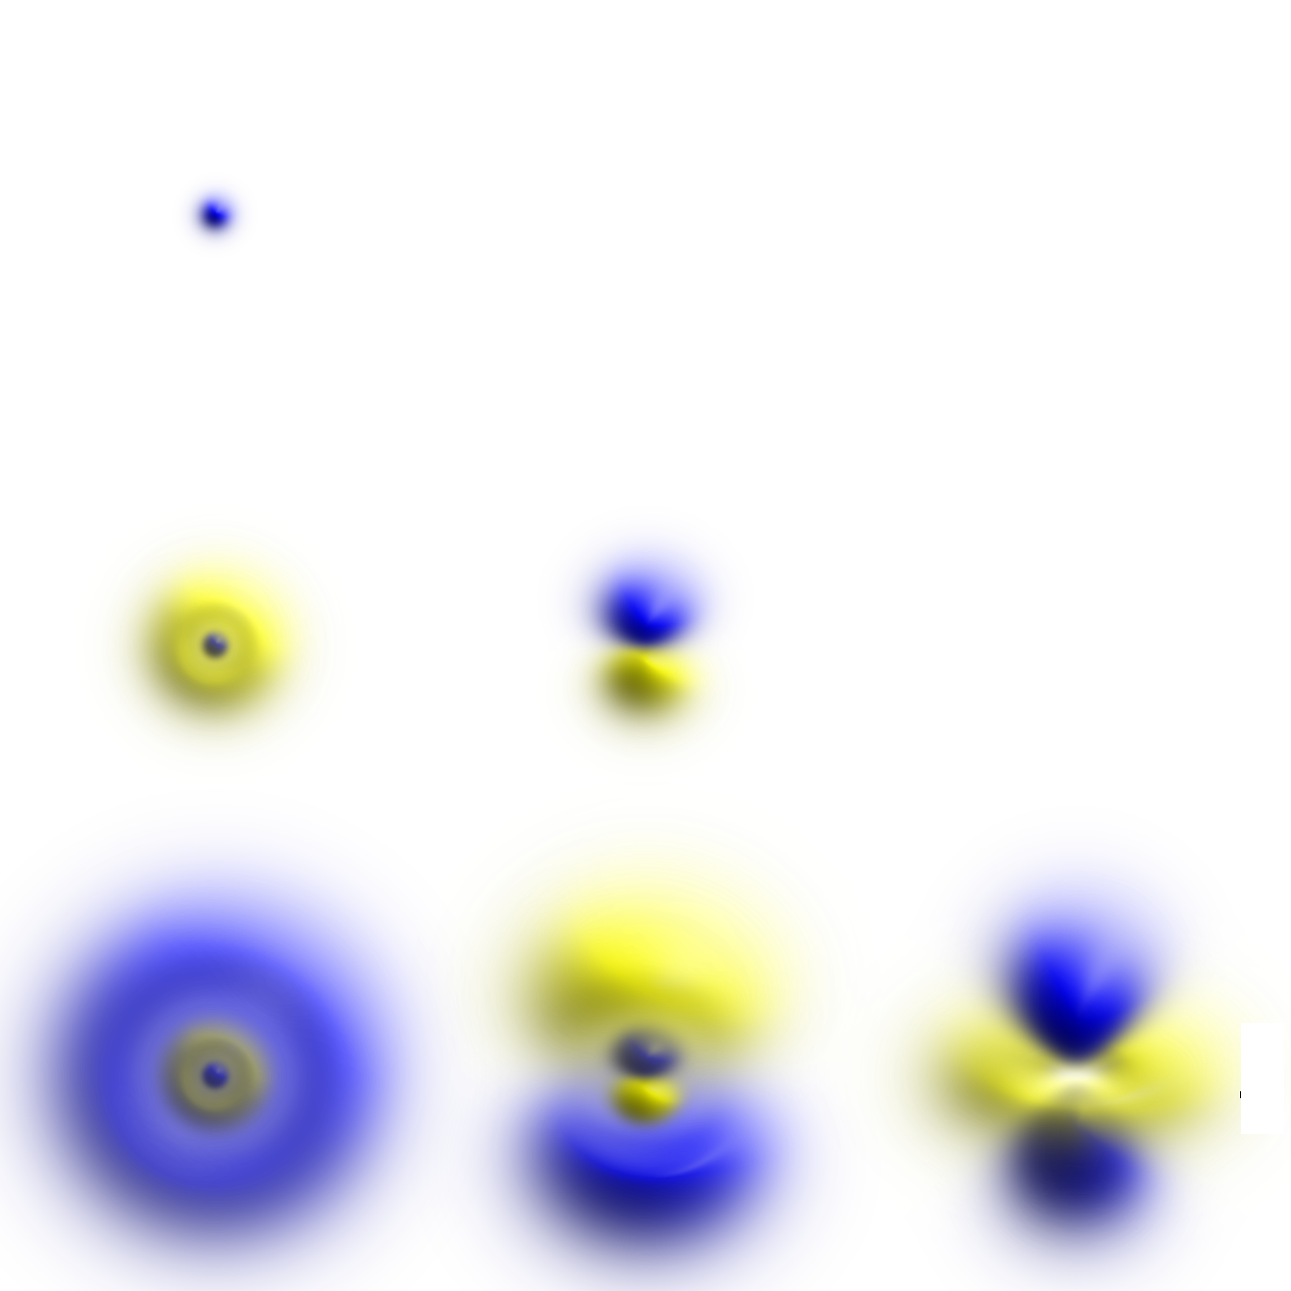
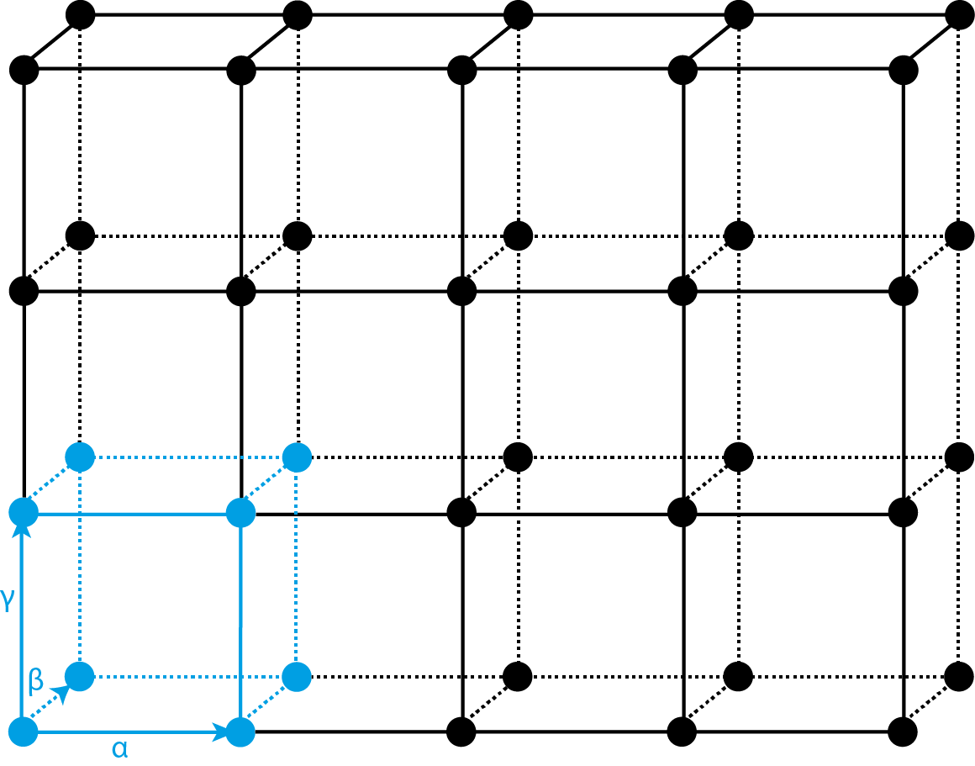
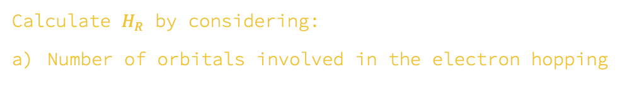
ACTUAL METHODS
4
13
20
Calculate $H_{R}$ by considering:
Number of orbitals involved in the electron hopping
b) The number of unit cells (relative to the home unit cell) involved in the hopping.

Slide 14

ACTUAL METHODS
4
14
Fourier transform to reciprocal space (momentum space)
20
5
Perform checks on H(k) to check its validity, i.e., checking for Hermiticity.
$$H=H^{+}={\left(H^{T}\right)}^{∗}$$
Notes:
TODO:
ADD CODE SNIPPET
EXPLAIN THE SIGNIFICANCE OF WORKING IN RECIPROCAL SPACE, IN THIS CASE, MOMENTUM-SPACE.

Slide 15

RESULTS & CONCLUSION
04.
15
20
Oh, what did we find?

Slide 16
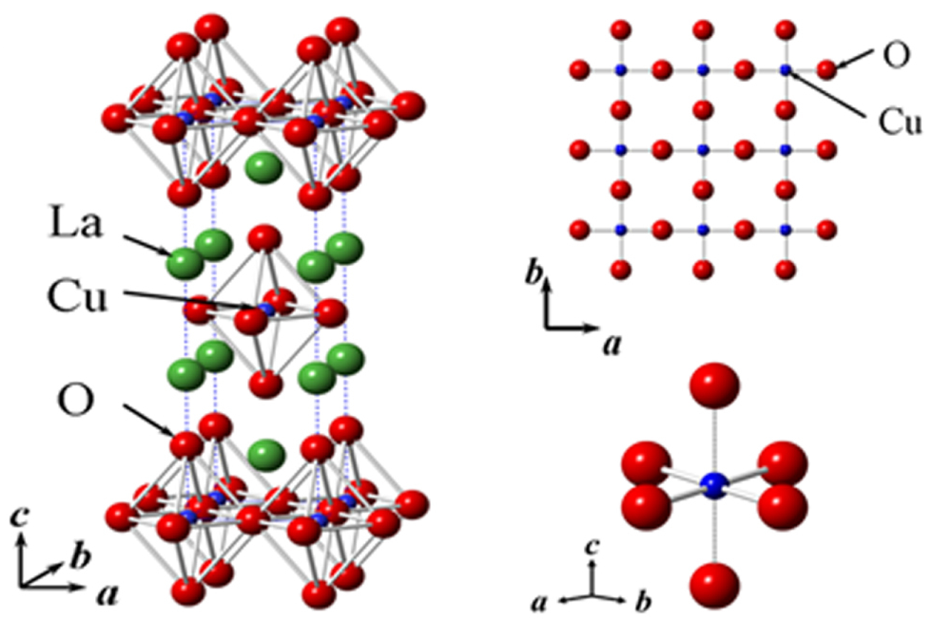

MATERIALS TESTED
We tested the code on different materials:
Palladium cobalt oxide (PdCoO₂) – Olivier’s experimental colleague’s material.
b) 1D cuprate of Strontium (SrCaCu₂O₄) – under intensive investigation at the CCQ.
16
20
c) Lanthanum cuprate (La₂CuO₄) – a superconductor

Slide 17
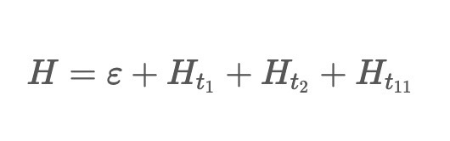
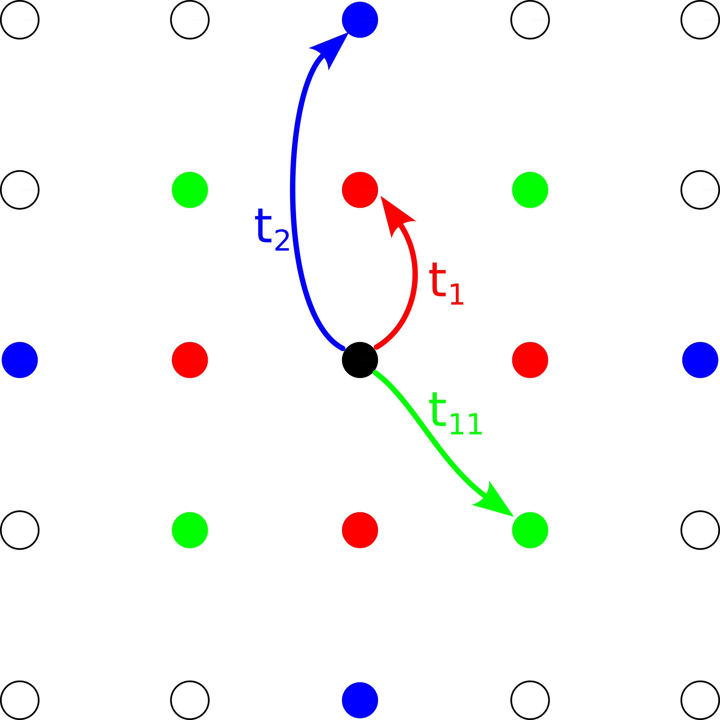
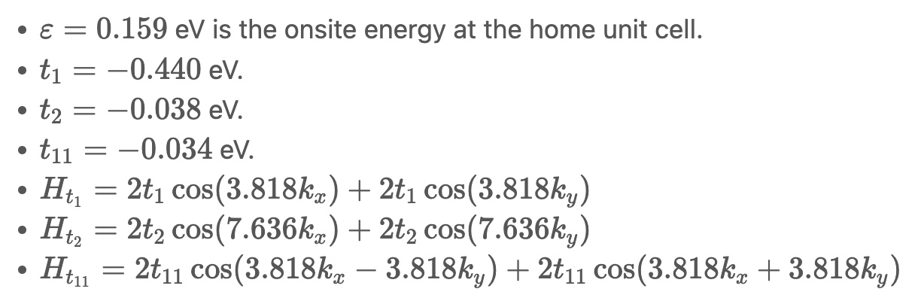
Results on La₂CuO₄.
Upon examination of the Wannier90 output file (hopping amplitude cutoff 0.038 eV) resulted in the subsequent Hamiltonian expression:
17
20
Where:
Symmetrical hops evident
Notes:
TODO / MENTION:
The Hamiltonian efficiently captures essential features of the crystalline material, such as the onsite energies of the home unit cell and the hopping amplitudes SYMBOLICALLY.
THE ANALYTICAL HAMILTONIAN IS A 1-BY-1 MATRIX SINCE ORBITAL HOPPING ONLY OCCURS WITHIN ONE ORBITAL TYPE HERE.
T_11 IS THE DIAGONAL HOPPING TERM.
SYMMETRY.

Slide 18
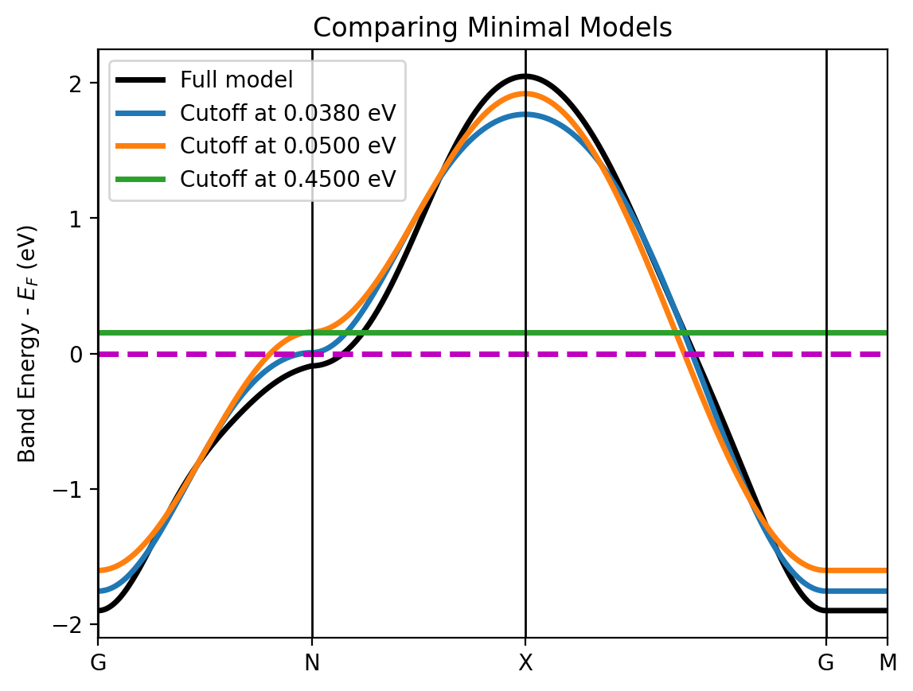
COMPARING MINIMAL MODELS.
The lower the cutoff, the better the model resembles the full Wannier90 model
Included in the tutorial.
18
Easy to see how user’s cutoff choice performs against full Wannier90 model
20

Slide 19


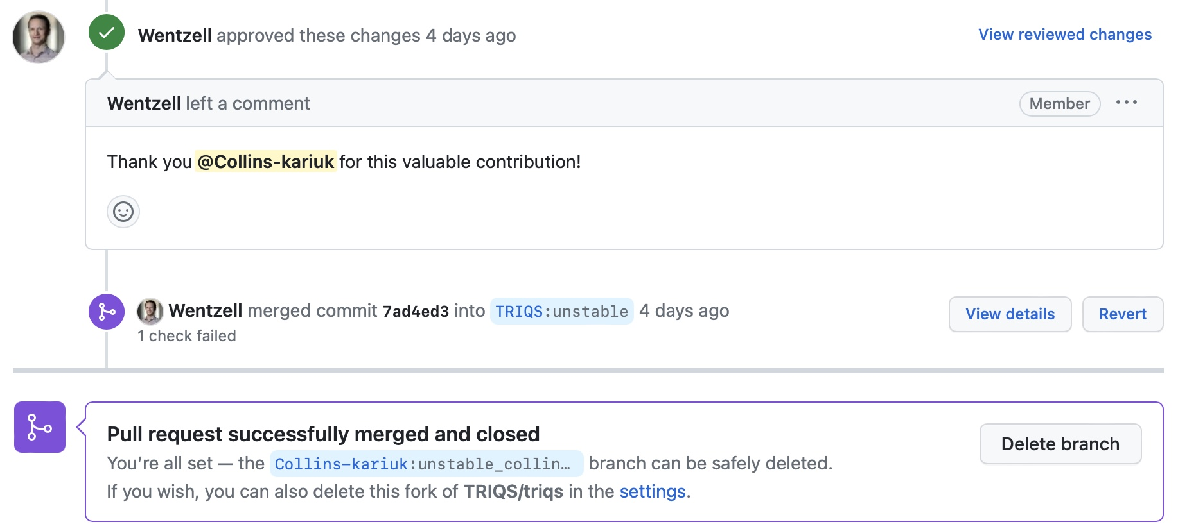











ACKNOWLEDGEMENTS
Simons-NSBP 2023 cohort
Office Colleagues
Organizations
AWESOME ADVISORS!
Data Science team
Stewart
Jože
Wladislaw
Olivier Gingras
Sophie Beck
Nils Wentzell
Alexander Hampel
Jaylyn
Zhen
Xavier
Notes:
MOTT INSULATORS are a class of materials that are expected to conduct electricity according to conventional band theories but turn out to be INSULATORS (at low temperatures).
A MOTT TRANSITION is a transition from a metal to an insulator, driven by the STRONG INTERACTIONS between electrons.
One of the SIMPLEST models that can capture MOTT TRANSITION is the HUBBARD MODEL.
Adjusting Model Parameters: Tight-binding models have parameters, such as hopping amplitudes and onsite energies, that define the electronic behavior of a material. Experimentalists can adjust these parameters to best fit the experimental data. The fitting process involves finding parameter values that minimize the difference between the calculated model results and the measured ARPES spectra.
Extracting Material Properties: By fitting the tight-binding model to ARPES data, experimentalists can extract important material properties such as band structure, band gaps, effective masses, and Fermi surfaces. These properties provide insights into the electronic and transport properties of the material.

Slide 20
References
S. Cheong, J. Thompson, and Z. Fisk, “Properties of La2CuO4 and Related Compounds,” Physica C: Superconductivity 158, 109–126 (1989).
A. Einstein, “Concepts in Condensed Matter Physics: Tutorial I,” (n.d.).
J. Kaye, S. Beck, A. Barnett, L. Van Muñoz, and O. Parcollet, “Automatic, high-order, and adaptive algorithms for Brillouin zone integration,” (2023).
M.P. Marder, Condensed Matter Physics, 2nd ed (Wiley, Hoboken, N.J, 2010).
Quick Quantum, “Tight Binding Model – QuickQuantum.co.uk,” (n.d.).
M. Roy, “The Tight Binding Method,” Rutgers University 5, 57 (2015).
R. Scalettar, “An Introduction to the Hubbard Hamiltonian,” Quantum Materials: Experiments and Theory 6, (2016).
K. Wang, B. Ecker, and Y. Gao, “Angle-Resolved Photoemission Study on the Band Structure of Organic Single Crystals,” Crystals 10(9), 773 (2020).
H. Zhang, T. Pincelli, C. Jozwiak, T. Kondo, R. Ernstorfer, T. Sato, and S. Zhou, “Angle-resolved photoemission spectroscopy,” Nat Rev Methods Primers 2(1), 1–22 (2022).

